Slide 1
Mars Ingenuity Helicopter

Slide 2
What do you know about Helicopters?
Notes:
Have students begin by filling in the What I Know column of the “Helicopters” KWL chart on your worksheet.
Lead a group discussion: Ask students to describe how a helicopter flies. Elements of their description should include fast-moving, horizontal, rotary blades.

Slide 3
What Questions do you have about Helicopters?
Notes:
Have students fill in the second column of their KWL chart by writing down questions they have about helicopters.

Slide 4
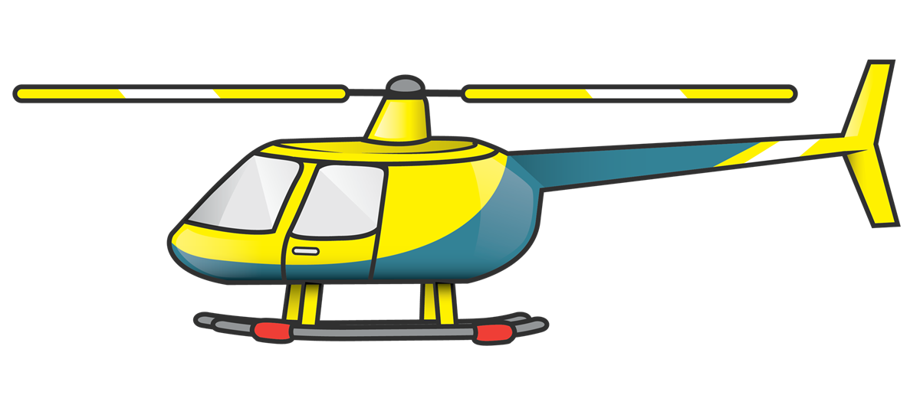
How do Helicopter Fly
Rotary blades are slightly angled so they can push against the air and lift the helicopter off the ground.
What else rotates and pushes against the air?
Lift
Gravity
Notes:
Ask students what else rotates and pushes against air (e.g., a fan). Ask students to compare and contrast a fan with a helicopter. For example, both move air in similar manners, but the helicopter moves a large volume of air downward while a fan usually moves a smaller volume of air toward us.
Explain that a helicopter moves so much air with its large, fast-moving blades, that the force of the blades against the air can overcome the weight of the helicopter and push it up off the ground. The helicopter is working against the force of gravity – which is constantly pulling the helicopter down toward the ground – and generating an upward force called “lift” by rotating its blades through the air. When the force of lift is greater than the force of gravity, the helicopter rises from the ground and flies.
Helicopter, https://pngimg.com/image/80027

Slide 5
Engineering a Helicopter
for Mars
Notes:
Ask students if a helicopter might fly differently on the Moon or Mars and why. Note: The Moon doesn’t have an atmosphere in which to generate enough lift to fly. Mars has a very thin atmosphere that may be able to support a small helicopter with very fast-moving blades. NASA’s Mars Ingenuity helicopter was designed to test if this is feasible. Ingenuity is a technology demonstration. In other words, the goal is to see whether it can fly on the Red Planet and study how the design could be improved for a future Mars helicopter.

Slide 6
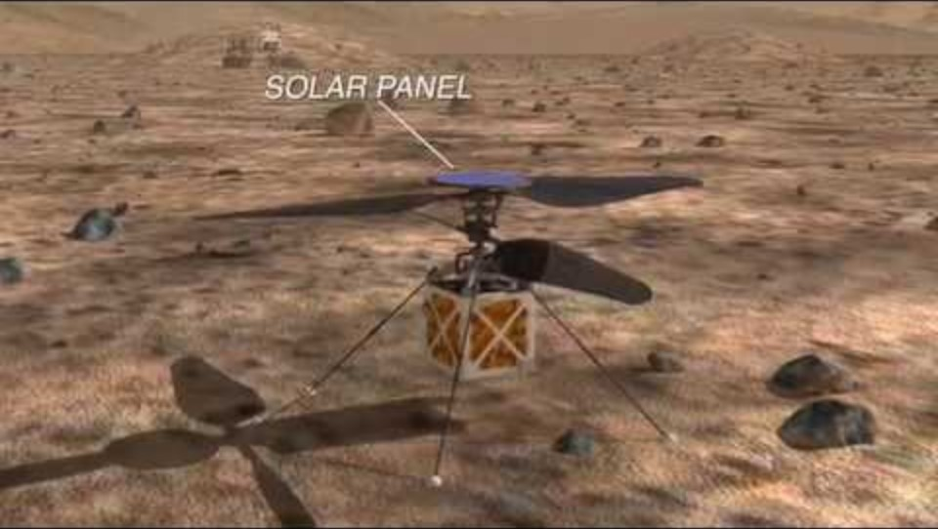
Engineering a Helicopter for mars
Notes:
Crazy Engineering, NASA Jet Propulsion Lab, https://www.youtube.com/watch?v=vpBsFzjyRO8&t=4s

Slide 7
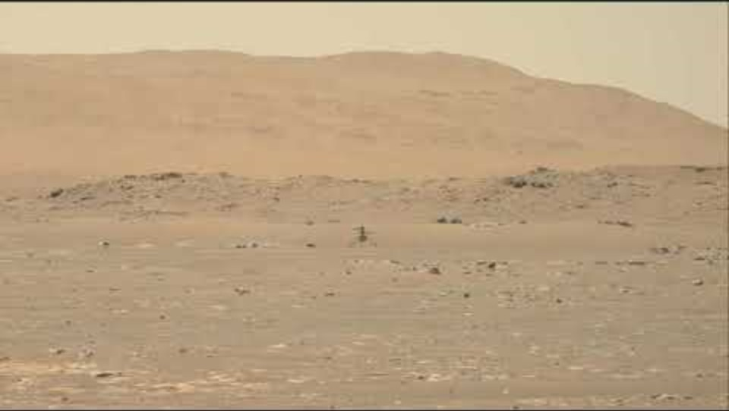
Ingenuity First Flight
Notes:
Ingenuity arrived on Mars with the Perseverance Rover on Feb 18, 2021.
Ingenuity made the first flight on April 19, 2021.
First Video of NASA’s Ingenuity Mars Helicopter in Flight, Includes Takeoff and Landing (High-Res), NASA Jet Propulsion Lab, https://www.youtube.com/watch?v=wMnOo2zcjXA

Slide 8
Choose your Challenge
How can you make their blades turn faster or slower?
How can you make the blades turn in the opposite direction?
How does a different kind of paper affect performance?
How big of a helicopter can you make that will still work?
How small of a helicopter can you make that will still work?
How do helicopters with different blade sizes compare in performance? What size works best? How do you define "best performance"?
Notes:
Ask students what they might change about their helicopter to affect its performance. Encourage them to make one change to their helicopter and do another drop. If students have a hard time thinking of changes, suggest they try making one more fold on the bottom of their helicopter, or try shortening or changing the shape of the blades. How does the performance change? Why does the chosen change have this effect? Have students share their changes and results.

Slide 9
Discussion
Which helicopters reach the ground sooner: those that rotate faster or slower?
How does the speed of rotation affect the flight of a real helicopter? How might this be important when designing a helicopter for Mars?
How was your experience designing and testing a paper helicopter similar to how NASA engineers designed and tested the Ingenuity Mars helicopter?
Notes:
Have students complete the What I Learned column of their KWL chart by filling in things they learned about helicopters in this activity.

Slide 10
Questions?

Slide 11

Credits
Clipart:
Helicopter, https://pngimg.com/image/80027
Videos:
Crazy Engineering, NASA Jet Propulsion Lab, https://www.youtube.com/watch?v=vpBsFzjyRO8&t=4s
First Video of NASA’s Ingenuity Mars Helicopter in Flight, Includes Takeoff and Landing (High-Res), NASA Jet Propulsion Lab, https://www.youtube.com/watch?v=wMnOo2zcjXA
This presentation template was created by Slidesgo, including icons by Flaticon and infographics & images by Freepik
Oklahoma State University, as an equal opportunity employer, complies with all applicable federal and state laws regarding non-discrimination and affirmative action. Oklahoma State University is committed to a policy of equal opportunity for all individuals and does not discriminate based on race, religion, age, sex, color, national origin, marital status, sexual orientation, gender identity/expression, disability, or veteran status with regard to employment, educational programs and activities, and/or admissions. For more information, visit https://eeo.okstate.edu.

