Slide 1
Egg Drop Challenge
Notes:
Once a spacecraft has launched, the next step is landing it on another planet. In this activity you will use the Engineering Design Process to design, build, and test a lander for your spacecraft.

Slide 2
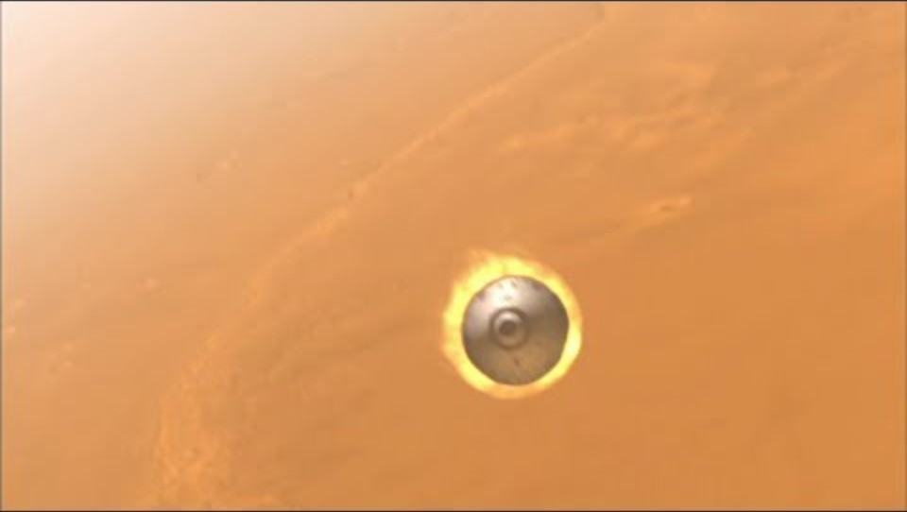
Mars Spirit/Opportunity Landing
Notes:
Mars Spirit/Opportunity Landing animation, NASA Mars Exploration, https://mars.nasa.gov/resources/20314/mars-exploration-rover-mission-animation/
https://www.youtube.com/watch?v=b_lPbSdkLKM&t=91s

Slide 3

Curiosity’s 7 Minutes of Terror
Notes:
Curiosity’s 7 Minutes of Terror, NASA Jet Propulsion Laboratory, https://www.youtube.com/watch?v=Ki_Af_o9Q9s&t=1s

Slide 4
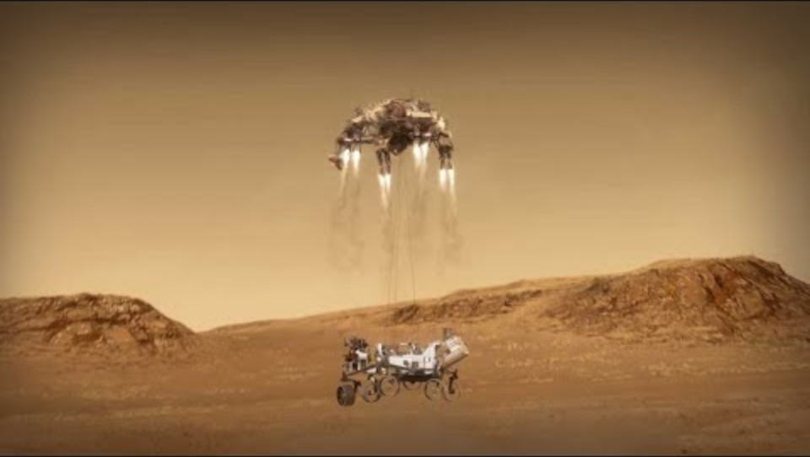
Mars Perseverance Landing
Notes:
Perseverance arrives at Mars, NASA Jet Propulsion Laboratory, https://www.youtube.com/watch?v=tITni_HY1Bk&t=1s

Slide 5
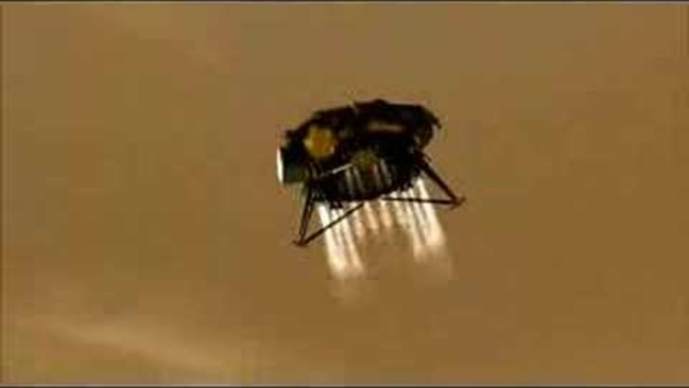
Phoenix Mars Landing: Nerves & Joy
Notes:
Phoenix lands on Mars, NASA Jet Propulsion Laboratory, https://www.youtube.com/watch?v=hH5pNFROlYU

Slide 6
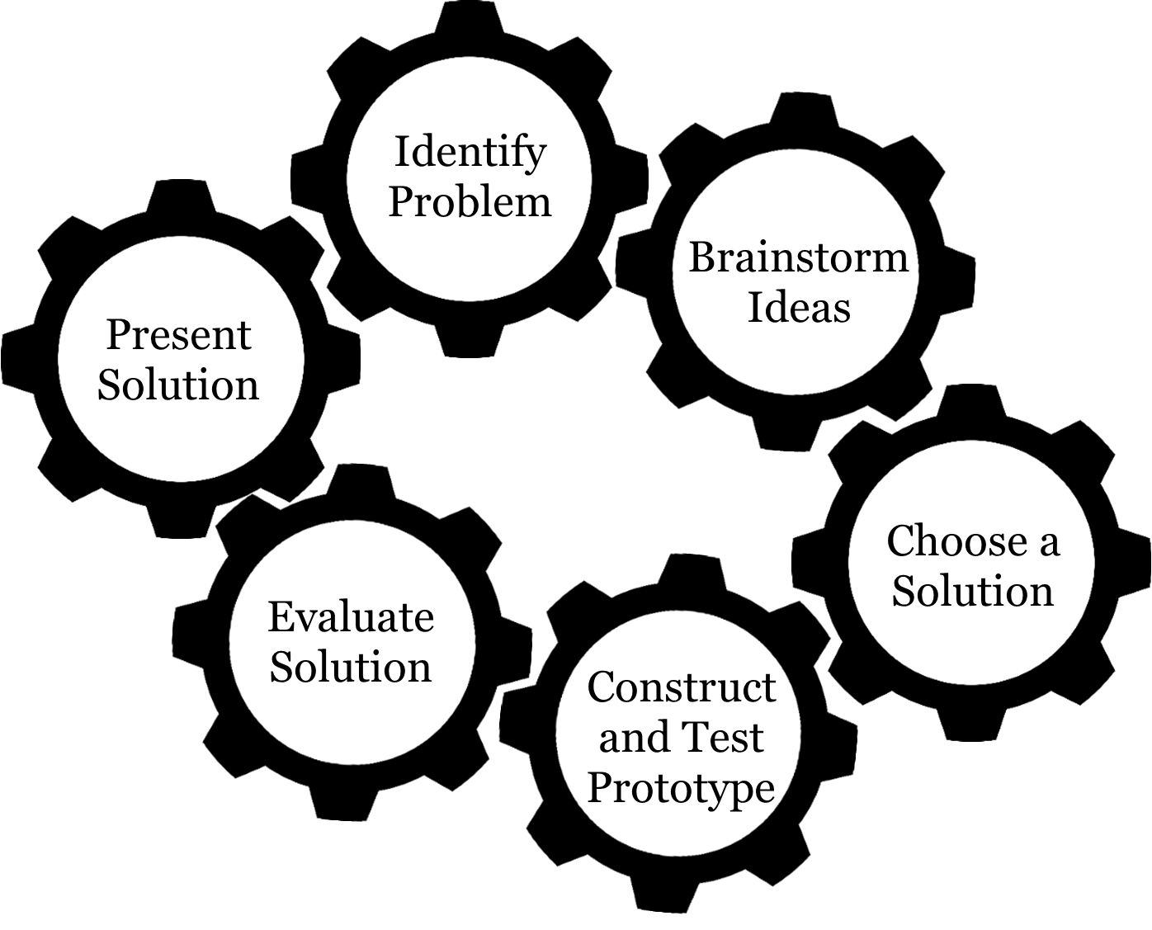
Engineering Design Process
Notes:
Tell your students they will design, build, and test a device to safely deliver a payload to the surface. Show or tell students the location (height) where their object will be dropped. You may want to drop a raw egg, unprotected, from the site to give students a visual.
Have students Identify the Problem on their workshet. Encourage them to state the problem in their own words.

Slide 7
Video Discussion Questions
What features did you notice from the video(s) that helped the spacecraft land safely?
Have you done an activity like this before? What did you learn?
What are other devices designed to protect fragile things (helmets, air bags, parachutes, etc)?
How do they work? What are they made of?

Slide 8
Engineering Constraints
Save a copy of this presentation and add in your rules/requirements for this activity - remember these are also called Engineering Constraints. Be sure to include the drop height for this activity and how long students will have to build.
See list of suggested rules in the guide.
Science Buddies provides additional guidance and includes an editable rules document. You will need to create a free account to access the full lesson.
https://www.sciencebuddies.org/teacher-resources/lesson-plans/egg-dropengineering-design

Slide 9

Brainstorm ideas
Notes:
How could you solve the problem? Try and think of as many ideas as possible!

Slide 10

Choose a solution
Notes:
Work together to choose a design to build. Keep in mind your solution could incorporate ideas from several people!

Slide 11

Construct and test a prototype
Notes:
Encourage students to test out their design. They can perform a test drop by having a member of their group hold the lander as high as they can and drop it. Make changes based on how the lander does in the test drops.

Slide 12

Evaluate solution
Notes:
What worked? What didn’t? How would you change your design?

Slide 13

Present solution

Slide 14
Reflection
What ideas did people have? Any similar ideas? Any unique ideas?
What problems did you have? How did you solve them?
What did you learn in your initial test? What changes did you make?
What were the results of the final test?
Which devices survived the most drops? Did they have anything in common?
Record these and other thoughts in your Mission Notebook.

Slide 15
Questions?

Slide 16

Credits
Videos:
Mars Spirit/Opportunity Landing animation, NASA Mars Exploration, https://mars.nasa.gov/resources/20314/mars-exploration-rover-mission-animation/
Curiosity’s 7 Minutes of Terror, NASA Jet Propulsion Laboratory, https://www.youtube.com/watch?v=Ki_Af_o9Q9s&t=1s
Perseverance arrives at Mars, NASA Jet Propulsion Laboratory, https://www.youtube.com/watch?v=tITni_HY1Bk&t=1s
Phoenix lands on Mars, NASA Jet Propulsion Laboratory, https://www.youtube.com/watch?v=hH5pNFROlYU
Engineering Design Process Gears graphics designed by Kelly Wardlaw
This presentation template was created by Slidesgo, including icons by Flaticon, and infographics & images by Freepik
Oklahoma State University, as an equal opportunity employer, complies with all applicable federal and state laws regarding non-discrimination and affirmative action. Oklahoma State University is committed to a policy of equal opportunity for all individuals and does not discriminate based on race, religion, age, sex, color, national origin, marital status, sexual orientation, gender identity/expression, disability, or veteran status with regard to employment, educational programs and activities, and/or admissions. For more information, visit https://eeo.okstate.edu.

