Slide 1
Design a Mission Patch

Slide 2
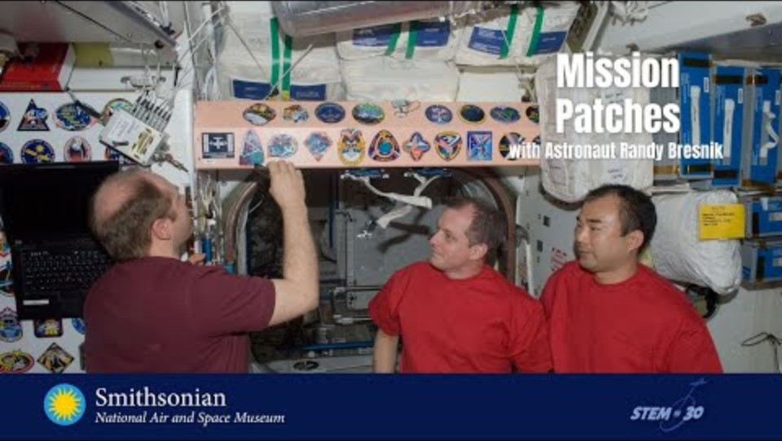
Mission Patches
Notes:
Make your own Astronaut Mission Patch, Smithsonian Air and Space Museum, https://www.youtube.com/watch?v=u6zHQ_GOoXc&t=2s

Slide 3

STS 34
Notes:
Our World: Mission Patches, NASAeClips, https://www.youtube.com/watch?v=KF3d_9zMGSo

Slide 4
Why do you think astronauts design mission patches?
Notes:
Mission patches have been worn by NASA astronauts since 1965.

Slide 5

Challenger
Credit: NASA
Notes:
STS-7 – What do you notice? What mission do you think this is for?
Sally Ride became the first American Woman in space on the STS-7 Mission, the symbol on the right represents the 4 male and 1 female crew members. The 7 stars and the shape of the arm reflect the 7 mission number.
Mission Patch Photos from NASA: https://history.nasa.gov/mission_patches.html

Slide 6

Kelly Houbaugh ect. Mission patch
Credit: NASA
Notes:
There is lots of symbolism on this patch! The star with the yellow lines is a symbol for astronauts, The gray silhouette is the International Space Station they were helping to build. The space shuttle is shown. The maple leaf is for Canada (Astronaut Williams is from Canada). The flame of knowledge on the left is a symbol for teachers (Astronaut Barbara Morgan was a teacher). There are 7 stars for the 7 astronauts.
Mission Patch Photos from NASA: https://history.nasa.gov/mission_patches.html

Slide 7

Kelly year in space
Credit: NASA
Notes:
This is a special patch made for Astronaut Scott Kelly’s and Cosmonaut Mikhail Kornienko’s year-long stay on the International Space Station. The 1 is for the 1 year in space and is made up of the US and Russian flags. The design represents the Space Station orbiting Earth and the earth orbiting the sun.
Mission Patch Photos from NASA: https://history.nasa.gov/mission_patches.html

Slide 8

Collins, Kelly patch
Credit: NASA
Notes:
STS-114
This is the “Return to Flight” mission patch. This flight represents the return to flight after the loss of the STS-107 Columbia crew.
The blue Shuttle shows the Columbia constellation of seven stars echoing the STS-107 patch.
The Earth represents the unity and dedication of the people whose efforts allow the Shuttle to return safely to flight. The shuttle astronauts names are shown in the white circle.
The Blue orbit represents the ISS and shows the names of the three astronauts who will work on the station during spacewalks.
The red sun signifies the Japaneses space agency (Noguchi is a JAXA astronaut)
The multi-colored Shuttle plume represented the challenges of the mission including Shuttle inspection and repair experiments and ISS resupply and repair.
Mission Patch Photos from NASA: https://history.nasa.gov/mission_patches.html

Slide 9

Apollo 11
Credit: NASA
Notes:
The Apollo 11 mission patch shows the command module (the Eagle) landing on the moon. The Eagle carries an olive branch showing we came in peace. Names are not included on this patch because the mission was “for all mankind”.
Mission Patch Photos from NASA: https://history.nasa.gov/mission_patches.html

Slide 10
Design a Mission Patch for your Team
What shape will you use for your design?
Instead of a mission number, groups could come up with a team name to use on their patch. What else could you use for a mission number (birthdays, ages…)?
What is something everyone in your group has in common? What makes each person unique? How can you include these on your patch?

Slide 11

Credits
Videos:
Make your own Astronaut Mission Patch, Smithsonian Air and Space Museum, https://www.youtube.com/watch?v=u6zHQ_GOoXc&t=2s
Our World: Mission Patches, NASAeClips, https://www.youtube.com/watch?v=KF3d_9zMGSo
Mission Patch Photos from NASA: https://history.nasa.gov/mission_patches.html
This presentation template was created by Slidesgo, including icons by Flaticon, and infographics & images by Freepik
Oklahoma State University, as an equal opportunity employer, complies with all applicable federal and state laws regarding non-discrimination and affirmative action. Oklahoma State University is committed to a policy of equal opportunity for all individuals and does not discriminate based on race, religion, age, sex, color, national origin, marital status, sexual orientation, gender identity/expression, disability, or veteran status with regard to employment, educational programs and activities, and/or admissions. For more information, visit https://eeo.okstate.edu.

