Slide 1
And Justice for All
In accordance with Federal law and U.S. Department of Agriculture (USDA) civil rights regulations and policies, this institution is prohibited from discriminating on the basis of race, color, national origin, sex, age, disability, and reprisal or retaliation, for prior civil rights activity. (Not all prohibited bases apply to all programs) USDA 2019
Notes:
July 31, 2023
This session is now fully recorded for playing during a face-to-face policy review with volunteers. The 26-minute recording is unpublished https://youtu.be/IhLouhbXEuk. It is not intended for use as an online learning management review. The online LMS will be completed through the Extension Foundation Campus @ https://campus.extension.org/ Details coming soon.
Discontinue the use of any 4-H Title VII & IX trainings dated prior to July 2023. Our policy review is being replaced with OSU Extension: Civil Rights for Volunteers - YouTube (12 min 39 sec) This recording is the current annual review of Title VI, VII, and IX for Volunteer, Staff and Advisory Committee Members being used by Extension.

Slide 2
4-H VOLUNTEER
Working with Minors
Cooperative effort of OSU Risk Management, Human Resources, & Legal Counsel
November 2022
Notes:
Extension Professional Notes:
On March 1, 2013 the OSU A&M Board of Regents approved policy 1-0135 regarding minors participating in OSU related activities and programs.
The purpose of the presentation is to inform 4-H volunteers the university community’s obligations to protecting youth who participate in activities and programs on university property, in university facilities, or under the authority and direction of the university at other locations, including branch campuses.
Before presenting WWM each year, make sure the most current version is being offered.
In preparation, make copies of documents mentioned. Thoroughly review and familiarize yourself with the content so it can be presented in a comfortable and relaxed environment which will facilitate discussion. The intent is not for the educator to “read” directly from the script or PPT slides.
Do not modify the context or content of this presentation without permission. The content has been approved by the University for presentation.
This session is not approved for training Extension professionals. A more detailed “Staff” version can be accessed through OSU Talent for annual training requirements.
** Photos – OSU Ag Photos, OSU Brand Management, Microsoft Office 360, and Unsplash.com, 2022

Slide 3
Purpose and Objectives
4-H Positive Youth Development
Ensure the safety and well-being of all minors
Informed volunteers representing OSU and Oklahoma 4-H
Proactive management of risk and liability
Oklahoma and Federal laws associated with the 4-H youth development efforts
Notes:
Presenter Script:
In 2013 the OSU A&M Board of Regents approved policy 1-0135 regarding minors participating in OSU related activities and programs.
Oklahoma State University requires both staff and volunteers complete an annual review of the OSU policy regarding work with minors.
This unit was created to be a floor, not a ceiling covering the policy. It does not address all of the possible situation and issues that a 4-H program might encounter. Volunteers are encouraged to continue their personal growth and understanding of risk management and best practices by participating in other educational opportunities.
Session content will increase ones understanding of:
Who is a minor and the importance of their safety and well-being
Behavioral expectation of Extension personnel, volunteers and teen volunteers entrusted to work with youth under the age of 18
University policy and Extension expectations when representing 4-H, conducting programming and being proactive in managing risk and liability
State Laws which apply to child welfare and 4-H programming
Nov 2023

Slide 4
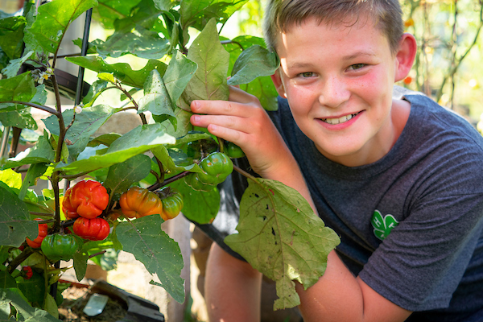
Who is a Minor?
Anyone under the age of 18.
Any 4-H/OCES sanctioned activity or event is considered an “extension” of the university campus.
Each of the following are under the authority and/or direction of the University
  Extension Office
  4-H clubs
  School Enrichment
  CNEP-EFNEP
  4-H Activities and Events at the C/D/S/N levels
  Day and Overnight Camps
  Workshops
  Practices/workouts, etc.
Notes:
OSU, OCES and 4-H Youth Development expects faculty, staff, volunteers, leadership teams, and teen volunteers who interact with youth under the age of 18 do so appropriately and in accordance with University policy.
The policy applies to ALL interactions with youth participating in 4-H club meetings, 4-H activities sponsored by a club, county/district/state activities and events, overnight camps, day camps, workshops, school enrichment/CNEP/EFNEP programs, practices and workouts, campus based activities, and/or any other Extension hosted program or activity.

Slide 5
Child Abuse and Neglect
Notes:
Any adult or teen choosing to represent the University and the 4-H program has accepted a responsibility to engage youth in learning opportunities that stimulate positive youth development.
Research has shown youth need to know they are cared about by others and feel a sense of connection. Adult and teen volunteers provide youth the opportunity to feel physically and emotionally safe through our program delivery. We create a safe and inclusive environment and foster a positive relationship with youth learners.
In doing so, we become aware of a child’s personal circumstances, which may include abuse and/or neglect.
Oklahoma law makes the reporting of known or suspected child abuse or neglect mandatory for all individuals who become aware of such behavior. All individuals, includes youth, parents, volunteers, Extension staff, and university personnel.

Slide 6
Reporting Responsibility
Child Abuse and Neglect
Agency | Phone Number
Emergency | 911
OKDHS Hotline | 800-522-3511
EthicsPoint | 866-294-8692
OSU Director of Human Resources | (405) 744-7420.
Under Oklahoma law you are required to report child abuse or neglect
No retaliation for reporting
Notes:
Anyone who knows or suspects that a child is a victim of child abuse or neglect, must act. In deciding whether or not to report an incident or situation, it is not required to have proof. Any uncertainty should be resolved in favor of making a report.
Anyone who makes a good faith report of child abuse or neglect may not be subjected to retaliation in employment with the university or association with the 4-H program.
Neither Oklahoma law nor any university policy allows you to delegate the duty to report child abuse or neglect.
Do not delay making a report in order to gather evidence; the law enforcement agency will determine whether such an investigation is warranted. It is better to report without all relevant information than to delay a report collecting information.
Do not directly question or solicit information from the child or from the person suspected of improper behavior. That is not your role; the role of investigation lies with city, county, and state officials.

Slide 7
Committed to Protecting
Oklahoma Youth
Steps in Reporting
Be prepared to report all known information.
Agency | Phone Number
Emergency | 911
OKDHS Hotline | 800-522-3511
EthicsPoint | 866-294-8692
OSU Director of Human Resources | (405) 744-7420.
Contact authorities in this order:
Oklahoma Department of Human Services (OKDHS) Abuse and Neglect Hotline 1-800-522-3511
  Child in imminent danger,
  immediately contact local police or county sheriff.
Local law enforcement
County Educator - within 24 hours, report to local Extension office
Notes:
Be prepared to report all available information regarding the known or suspected abuse or neglect, including, but not limited to, the name of the child, his/her whereabouts, the names and addresses of the parents, guardian, or caretaker and the character and/or extent of the injuries.
If known, include any evidence of previous injuries and/or pertinent information, including the identity of the person or persons responsible. Reminder, it is not your responsibility to investigate, only report what is known or suspected.
Your actions should be as follows:
Immediately report to Oklahoma Department of Human Services (OKDHS) Abuse and Neglect Hotline at 1-800-522-3511
If a child is in imminent danger, contact local police or county sheriff to obtain immediate protection for the child and then immediately call OKDHS.
Report to local law enforcement authorities
In addition to making a report to local law enforcement, within 24 hours report the information to the county educator

Slide 8

Failure to Act
Misdemeanor for not reporting
Failure to report is grounds for termination, dismissal or expulsion
Knowledge of someone’s failure to comply
Thank you
for your commitment
to the health and safety of
Oklahoma youth.
Notes:
By Oklahoma law, any person who knowingly fails to make the report shall be guilty of a misdemeanor.
University personnel and volunteers who willfully fail to report a case of suspected child abuse is subject to disciplinary action, up to and including dismissal.
Any 4-H volunteer, parent, teen, youth or employee who becomes aware of a failure to comply with this policy shall report such failure immediately to the Director of Human Resources (405) 744-7420 or through EthicsPoint at (866) 294-8692.
Your efforts in creating a safe and healthy environment for our youth is critical. 4-H Youth Development and the University appreciates your shared commitment.

Slide 9
Volunteer
Behavioral Expectations
Notes:
Oklahoma families and other youth programs trust that OSU and Langston Extension will provide a safe environment for youth participating in our programs.
The opportunity to work with youth is a privileged position of trust granted to those willing to demonstrate model behavior.

Slide 10
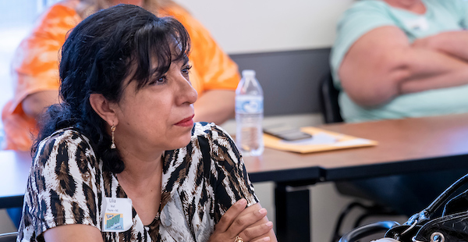
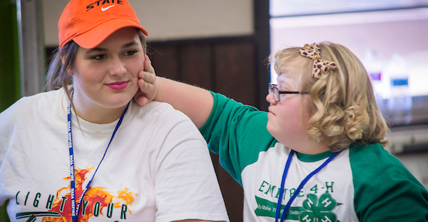
Behavioral Expectations
Role Model in all actions and deeds
Work cooperatively with youth, families, volunteers, staff, and others in a courteous, respectful manner…..
Represent Extension Service and the 4-H Program with pride and dignity,…. good sportsmanship and demonstrate reasonable conflict management skills.
Accept responsibility to support, promote, develop, conduct, and maintain a healthy and effective 4-H youth development presence ….
Respect, adhere to, and enforce rules, policies, and guidelines ….; this includes all state and federal laws related to child abuse, substance abuse, civil rights policies and regulations, etc.
Comply with equal opportunity and anti-discrimination laws. ….
Notes:
4-H volunteers are responsible for interacting with youth and families in a caring, honest, respectful, and responsible manner.
Annually certified adult volunteer sign a Behavioral Agreement as part of the enrollment process.
A copy of the waiver can be downloaded from your online enrollment profile.
**[In-person training – handout a copy of waiver.]
In this session we will only briefly review highlights.
** Review highlights 1-5 directly from slide.

Slide 11
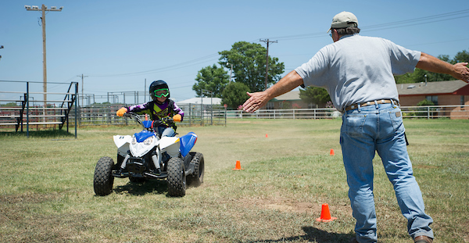
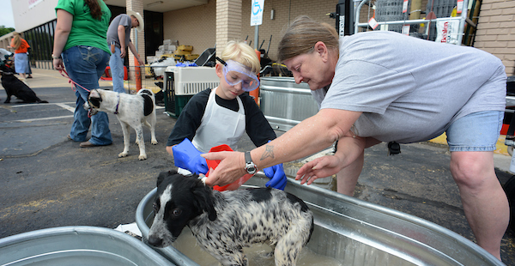
Behavioral Expectations Cont.
Continued…
Recognize that verbal, mental, or physical abuse, hazing or committing criminal acts, and/or being aware of such …. are grounds for termination…
Under no circumstance, allow or consume alcohol, illegal drugs, or any form of medical marijuana/marijuana products at 4-H programs…. being under the influence …. in the presence of 4-H youth…. are grounds for termination….
The use of tobacco and vapor products in the presence of 4-H youth and/or during 4-H Programs is strongly discouraged….
Treat animals humanely and encourage 4-H youth and adults to provide appropriate and ethical animal care.
Operate machinery, vehicles, and other equipment in a safe and responsible manner….
Notes:
Continued….
** Review highlights 6-10 directly from slide.
As stated in the signed behavioral agreement: A breach of the guidelines can be grounds for severing one's relationship as a volunteer for Oklahoma 4-H.
The guidelines apply to Volunteers and Extension employees and are not “all Inclusive,” OSU and Langston Extension reserves the right to adjust guidelines.

Slide 12
Risk and Liability Management
Notes:
Appropriate adult supervision is critical to all programs delivered on behalf of the university and 4-H.
Volunteers are expected to be diligent in identifying, understanding, and pro-active in avoiding potential risk and liability when planning and conducting programs.
In order to ensure consistency with the implementation of policy, the office of Legal Counsel has reviewed and approved a set of forms to assist volunteers and Extension staff in meeting the standards established by the University. These forms are “tools” to assist volunteers.
In the following section the forms will be introduced and applied to 4-H program development and delivery.

Slide 13
Proactive Risk and Liability Management
Supervising Minors
Avoid one-on-one contact with Minors
Adequate Supervision – certified volunteer(s) and/or Extension staff
Appropriate Youth-Adult ratio for the setting and activity
Meet in open well-lit spaces, with windows when possible.
Health care providers are an exception
Oklahoma 4-H Youth-Adult Ratio
These are minimal guidelines.
Age | Ratio
Cloverbuds 5–8-year-olds | One Adult to 6 youth
9-14 year olds | One Adult to 8 youth
15-17 year olds | One Adult per 10 youth
** Ages are based on the American Camping Institute guidelines, not OK 4-H grade/age guidelines.
Notes:
4-H sanctioned activities should always be chaperoned by more than one certified volunteer and/or Extension staff. Best practice, follow 4-H youth-adult ratio and have a minimum of two certified adult volunteers and/or Extension staff present when minors are in attendance.
Oklahoma 4-H has defined an appropriate “youth to adult ratio.” The ratio is based upon youth developmental level and needs. The setting and activity may necessitate additional supervision. The ratio is a positive risk management practice and more importantly, provides youth positive relationships with caring adults.
Do not meet with minors outside of designated activities without others present, for the safety of the minor and the supervising adult and teen volunteer(s). For example, do not invite individual minors to your home, rather include groups and/or involve the minor’s parents.
When at all possible, schedule programming in open, well-lit areas, preferable with doors that do not lock from the inside only. Please visit with Extension staff about appropriate locations.
**Source for Ratio - American Camping Institute 2022 https://www.acacamps.org/parents-families/why-accredited-camps/how-choose-camp-safety-tips

Slide 14
Activities involving Minors
Provide a safe space that challenges growth and life skill development
Provide a socially and emotionally healthy environment for positive youth development
Use “Activity and Event Intent” Form 7
Adequate supervision: appropriate Youth-Adult ratio for the setting and activity; certified 4-H volunteers and/or Extension staff chaperoning
Crisis Management Plan – page 3
Notes:
Any meeting, activity or event should be a safe space where youth can be challenged to grow and develop life skills.
Form 7 is an excellent tool for planning an activity or event outside of a regularly scheduled club meeting. It contains general information including the purpose for the activity/event, a physical address, contact information, participants, chaperones, insurance, travel plans, and a crisis management plan ** [Provide a copy to the volunteers.]
Why travel plans? This is to avoid possible side trips or personal stops which are not part of the planned event and could be a potential risk. If something would happen on such a stop, it would negate your OSU support and increase personal liability.
The form is to be filed with the Extension office prior to the activity or event (via email, scanned, mailed, or hand delivered). This provides the group/volunteer “protection” by documenting this an “officially recognized and sanction 4-H activity.” Keep a copy.
Page three, the Crisis Management Plan, will be useful in the event there is a critical situation which must be reported to the Extension office.

Slide 15
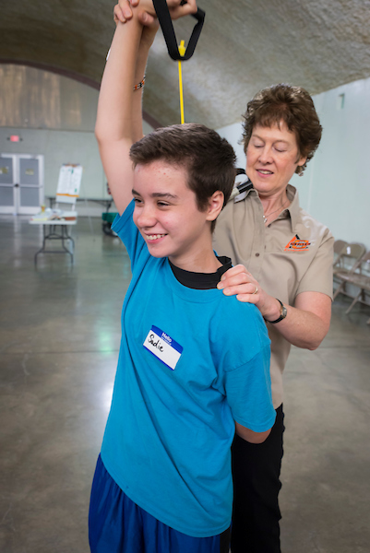

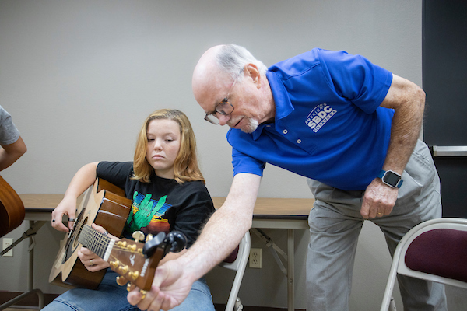
Physical Contact with Minors
Respect ANY sign of discomfort
Never use inappropriate touch
Appropriate physical contact:
  Open/public space
  In response to the minor’s needs – respectful redirection
  Consistent with program mission & culture
  As related to educational need, developmental need or health issue
No abuse of any kind
  Verbal
  Striking
  Hitting
  Punching
  If restraint is necessary incident must be documented.
Poking
Spanking
Restraining
Written
Notes:
While in the presence of minors watch and listen for ANY sign of discomfort or resistance to physical contact. Be sensitive and respectful to the simplest of signs.
Never touch a minor in a manner that could be interpreted as inappropriate. If touch is necessary, ask for permission before touching. Best practice is to use the heel of your hand with fingers extended or the back of your hand with hand relaxed.
In general, appropriate physical contact should only be in public and in response to the minor's needs, for a purpose that is consistent with the program's mission and culture, or for a clear educational, developmental, or health related purpose.
There will be occasions when respectful redirection of affectionate or inappropriate behavior will be necessary. Redirection is a quick in-the-moment strategy to give useful feedback by telling the youth that a particular action is not appropriate and/or redirecting the youth to a new activity or more appropriate behavior.. Using a calm tone, neutral body language, and clear, concise wording discreetly get the child’s attention and respectfully respond to their need with redirection.
Avoid any form of physical abuse, including verbal or written in the presence of, a minor.
If restraint is necessary to protect a minor, the incident must be documented and disclosed to the minor's parent/guardian, County Director, District Specialist, and State 4-H Program Leader. Document the situation using the WWM Incident and Accident form 8. The completed form is due to the Extension office within 3 days of the incident.

Slide 16
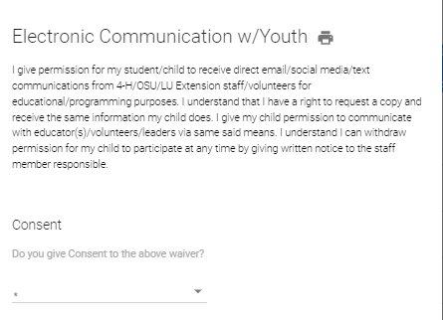
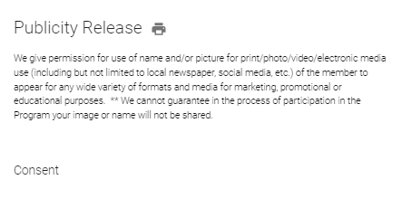
Social Media and Minors
Appropriate content
Required consent to communicate directly with minors via email, social media or text
Club social media accounts
Use of personal social media
Publicity – sharing the 4-H story with names and photos
Notes:
When using any form of social media or publicity be sure all content is appropriate.
As part of the enrollment process a parent/guardian had the right to accept or decline DIRECT communication via “direct email/social media/text communications from 4-H/OSU/LU Extension staff/volunteers for educational/programming purposes. “ It is our responsibility to respect the communication waiver. The Extension office can provide volunteers a list of families/youth who have declined communication. Families can withdraw permission at anytime, please be attentive to changes.
When direct communications occur with youth keep content appropriate and CC the parent. Best practice, would be to include both the parent and another certified volunteer in the messaging.
Any form of social media account established for a club, project group, event or activity should be on file with the Extension office.
Adults should not share “personal” social media with minors .
A Publicity waiver is signed annually by a parent/guardian indicating their right to accept or decline permission for use of a youth’s name and/or picture for print/photo/video/electronic media use. This includes local newspapers and any social media. It is our responsibility to respect the publicity waiver. The Extension office can provide a list of families/youth who have declined publicity.

Slide 17
Transporting Minors
Travel and Transportation Best Practices, Form 3
OSU Student Travel Policy 1-0133 (March 2015)
Be diligent of adequate adult supervision, road and weather conditions, vehicle maintenance and Oklahoma laws.
Notes:
When transporting minors, be diligent of adequate adult supervision, road and weather conditions, vehicle maintenance and Oklahoma laws.
The “Travel and Transportation Best Practices” outlines OK 4-H expectations when transporting youth to and from 4-H sponsored events, carpooling, use of privately owned vehicle, parental responsibilities for providing transportation, teens drivers, and more. ** [Provide a copy to participants. As time allows or during a separate session review the best practices in detail and provide time for discussion.]
Highlights of OSU General Student Travel Policy 1-0133 include: valid and approved driver’s license for the type of vehicle being operated; insured driver, vehicle liability insurance; and the vehicle is in safe driving condition. The entire policy can be downloaded from the OSU website. (https://adminfinance.okstate.edu/policies/html-pages/1-0133_student-travel.html

Slide 18
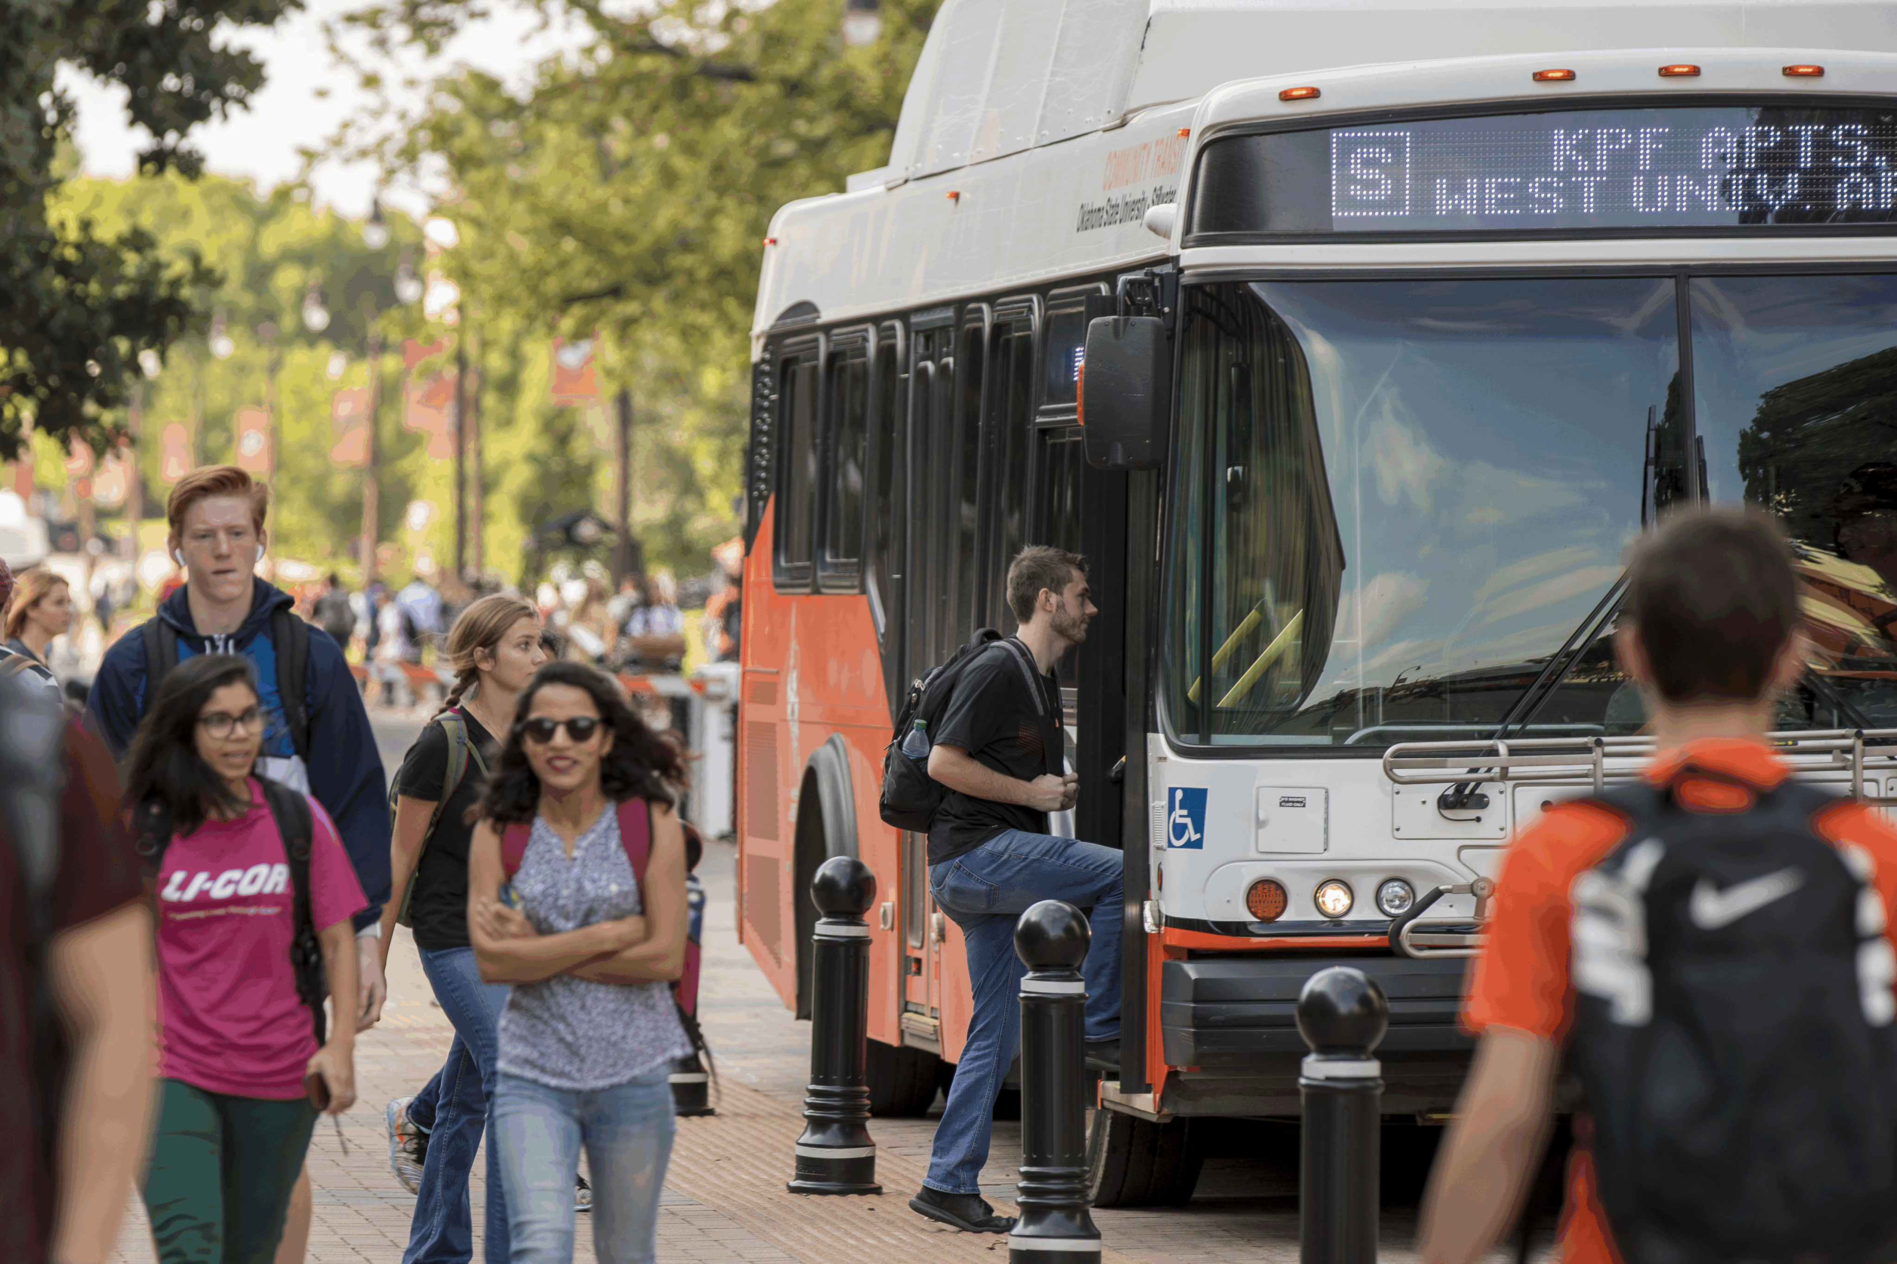
Transporting Minors continued…
More than one adult in vehicle
One working seatbelt per passenger
Knowledgeable of Oklahoma’s Graduated Driving Law
NEVER transport youth in the bed of a pickup.
Notes:
It is not advised to be alone in a car with a minor, who is not your child. For any special consideration please contact the Extension office.
When youth are driving others, give strong consideration to the Oklahoma Graduated Driving Laws.
While it is not against Oklahoma law, it is against OSU policy to transport people in the bed of pick up. The exception might be a trailer or pick up used in a parade where extreme caution should be used!

Slide 19

Substance use in the presence of Minors
Do not use, possess, or be under the influence of
alcohol, tobacco, illegal drugs
or any form of medical or marijuana product when
responsible for or in the presence of a Minor.
Per OK 4-H Adult Behavioral Agreement
Under no circumstance, allow or consume alcohol, illegal drugs, or any form of medical or marijuana products at 4-H Programs. Understand that the use of or being under the influence of alcohol, legal or illegal drugs while in the presence of 4-H youth and/or at 4-H Programs are grounds for termination as a volunteer or Extension educator.
The use of tobacco and vapor products in the presence of 4-H youth and/or during 4-H Programs is strongly discouraged, as the use of these products is illegal by minors.
Firearms
Notes:
Do not use, possess, or be under the influence of alcohol, tobacco ,illegal drugs or any form of medical or marijuana products when responsible for or in the presence of a minor.
It is also important that volunteers and educators follow all state laws and posted signage regarding firearms.
We respect Oklahoma state law, but we must also be mindful that we have been entrusted the care of someone's child and want to avoid any unforeseen circumstance where a firearm could injure a child.

Slide 20


Modesty with Minors
Modesty can be influenced by
culture, family, faith, and personal experiences.
Program Considerations:
Do not shower, bathe, or undress in the presence of Minors
  Schedule separate adult and youth shower times
  Facilities have appropriate modesty barriers
  Teen leaders/counselors practice modest behavior
Overnight Activities - Adults should not share a room with a minor unless it is their own child
Camping Experience - In a camp setting where adults must share a cabin or tent with multiple youth; parents/guardians should be notified in writing and/or at an orientation before the event.
Notes:
4-H defines modesty as behavior, manner, or appearance intended to avoid impropriety or indecency. Modesty can be influenced by culture, family, faith, and personal experiences. When working with minors provide the utmost respect for an individual’s personal modesty.
When planning programs which may involve overnight experiences or the need to change clothes, incorporate the following:
Do not shower, bathe, or undress in the presence of minors.
Teen who are 18 or older should be especially aware they are now legally considered an adult. A parent could express concern about their lack of good judgement or modesty in the presence of minors. As a reminder, a minor is defined as anyone under the age of 18.
Any teen, put in a leadership role to supervise other youth, should have an acceptable level of maturity and responsibility, as well as provided adequate training for their role.
When “overnight” activities are scheduled, youth and non-custodial adults are not to share a room. Youth should be housed with other youth. For an exception to occur, such as a “camping experience”, it must be disclosed and pre-approved by the parent(s)/guardian.
Please understand that “Adults,” has a plural meaning in this context, meaning teen leader/counselor, adult volunteers and staff. Best practice is two teens/counselor or two adults in a cabin or tent. For the protection of the campers and those assuming a leadership role, do not place one “designated” responsible teen or adult in a potentially compromising situation.

Slide 21
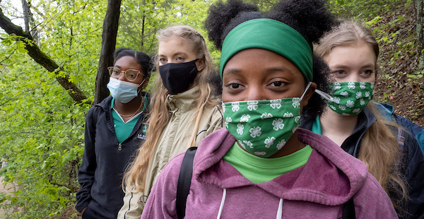

Health and Safety
Current youth/adult Health form - Knowledgeable of allergies, dietary needs, physical, behavioral or mental health conditions
Medical attention necessary
  When possible, contact the parent/guardian for approval
  Emergency - Seek medical care until which time a legal representative can assume responsibility for the individual’s care and treatment.
Document incidents or accidents, Form 8
  An incident could be harassment, hazing, bullying, inappropriate language, a threat (verbal, physical, mental), inappropriate use of electronics/internet, etc.
  An accident could be simple first aide - bump, scrape, cut, scratch, bug bite, headache, stomach ache, etc. needing attention/medication.
  An accident includes emergencies or medical treatment requiring professional attention.
  Accident can also be defined as involving car, equipment, ATV, bicycle, tractor, boat, animal, etc.
Notes:
Best practice – Have a current health form for youth and adults participating in activities and events outside a regularly scheduled club meeting when a parent is not present to assume legal responsibility in the event of an accident, injury or illness. Some volunteers choose to be cautious and have health forms available at club meetings.
While a child is under our care and supervision it is wise to be knowledgeable of allergies, dietary needs, physical, behavioral or mental health conditions that would limit participation in normal activities/projects. Make reasonable effort to accommodate their needs.
The information contained in a health form is to be held in strict confidence and is to be used only for youth and program safety needs or medical emergencies.
In cases where medical attention is necessary, the parent/guardian will be contacted for approval when possible; however, in the event of an emergency the 4‐H staff/volunteer are to seek medical care for any Participant until which time a legal representative can assume responsibility for the individual’s care and treatment.
Make it common practice to have form 8 on hand at all 4-H events, activities and club meetings. This form is to be used by both Extension staff and volunteers to document Incidents or Accidents. ** Read from slide Incident defined… Accident defined…
The person in charge or responsible completes and files the form within 3 days of the actual occurrence.

Slide 22
Volunteers, not “Certified”
Notes:
Any adult or teen choosing to represent the University and the 4-H program accepts the responsibility to engage youth in safe learning opportunities that stimulate positive youth development.
The 4-H formalized certification process is our way of protecting the vulnerable population we serve.
Certification includes but is not limited to: Club/Cloverbud/Project Leaders and/ or general Club Volunteers, chaperones, and adults transporting youth as part of a sanctioned 4-H program.

Slide 23
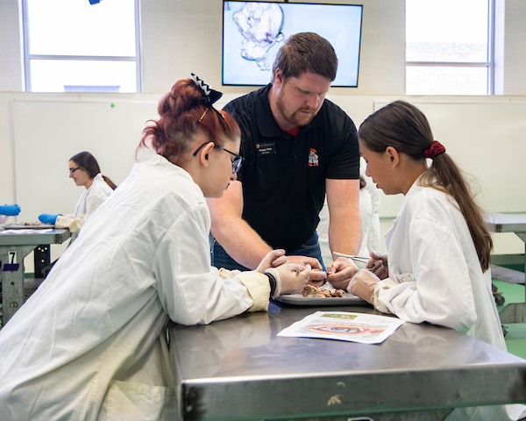
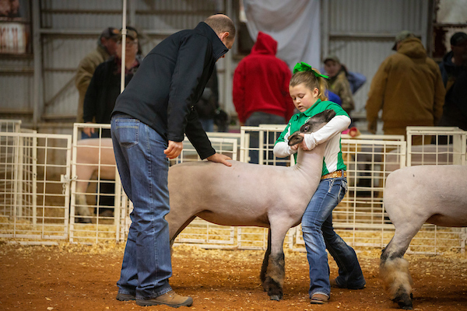
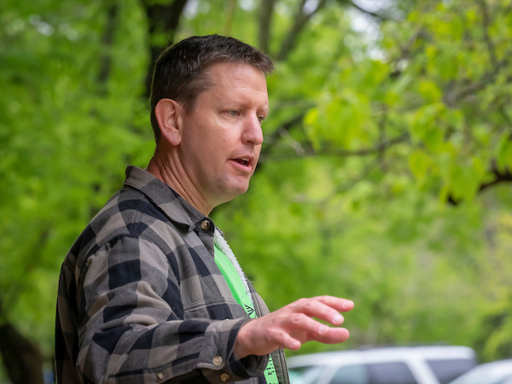
Episodic Volunteers
Parent or community volunteer NOT Certified by 4-H
“Episodic” - People engaged as short-term resources. Valuable volunteers who provide expertise, program support, and extra-hands.
These volunteers include: a guest speaker or teacher, judge, workshop helper, room monitor, clean-up crew, parent/guardian, and many, many more!
Notes:
It is understood not everyone will be ready to go through the extensive process of certification. Some people will want to assist the 4-H program on a short-term basis as a parent, guest speaker or instructor, workshop helper, room monitor, clean-up crew, etc. These “episodic” volunteers are respected and valuable community resources.
As valued as they are, we cannot allow them to oversee or chaperone youth without direct supervision of a “Certified” 4-H volunteer(s) or Extension staff member. As a “certified volunteer,” our priority is first and foremost, the protection of the minors entrusted to our program.

Slide 24
Statement of Understanding
All Volunteers of the University and 4-H
Non-Certified Adult Volunteer – Form 5
Statement of Understanding - RISK and RELEASE OF CLAIMS, PUBLICITY RELEASE FOR USE WITH NON-CERTIFIED 4-H VOLUNTEERS
Form includes:
  Statement of Understanding
  Publicity Release
  Emergency information and Authorization for Medical Care
  Assumption of Risk and Release of Claims
In Addition - Position Description and/or Orientation
Notes:
As a public institution, the University must ensure compliance with federal statutes of the Department of Labor governing employment and volunteerism. To maintain compliance, OSU Volunteer guidelines are in effect for both certified and episodic 4-H volunteers.
Form 5 is designed ONLY for the episodic volunteer and includes the Statement of Understanding, Publicity Release, Medical care, and the Assumption of Risk.
Provide the volunteer a simple written description of their responsibilities. Not a lot of detail, but enough information that it reflects their general duties. Why bother? This is a good risk management practice in the event a volunteer is negligent, does something illegal or inappropriate.

Slide 25

In Summary
4-H - Committed to the Health and Safety of OK Youth
Key Policy Points
  Transportation
  Appropriate supervision
  Appropriate forms/documentation
  First aid and medical treatment
  Plans for severe weather
  Curfews
  Code of conduct
  Prohibition of alcohol, tobacco, and illegal drugs
  Adequate supervision by adults
Minors Participating in OSU Related Activities and Programs
University Policy – 1-0135
Notes:
Because Oklahoma 4-H is committed to the health and safety of our youth; volunteers, teens and staff will be expected to annually complete a review of the Working with Minors guidelines.
As engaged volunteers, we appreciate the time and effort necessary to consciously work to comply with Oklahoma State University's policy regarding minor children participating in activities and programs taking place on university property, branch campuses, and at facilities under the authority and direction of the Extension.
These policies apply to the 4-H club and club activities, county/district/state/national 4-H activities & events and any other OCES youth development activities.
Portions of the working with minors policy and guidelines have no flexibility and must be adhered to, others as noted are more general best practices and should always be given the highest consideration.
Please continue to “Make the Best Better” by participating in other 4-H continuing education opportunities hosted by 4-H at the county, district, state and national levels.

Slide 26
Name Of Presenter
Department of This Slide Goes Last
O | 000.000.0000
C | 000.000.0000
E | name.presenter@okstate.edu
Address Goes Here
City, State
May 2022
Working with Minors Forms https://4h.okstate.edu/educators/forms-and-applications/index.html
Oklahoma 4-H https://4h.okstate.edu/
Volunteer Resources https://4h.okstate.edu/volunteers/index.html

