Slide 1
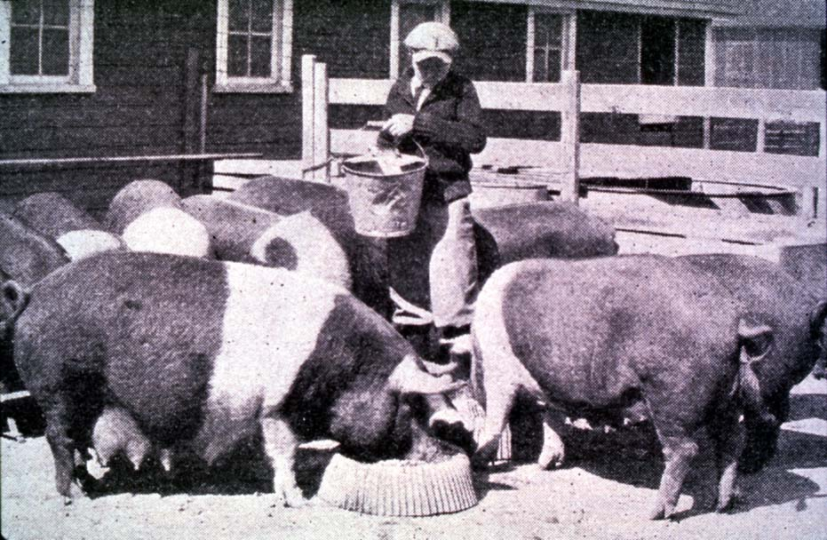
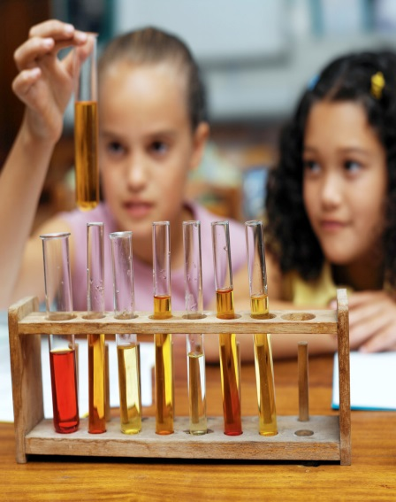


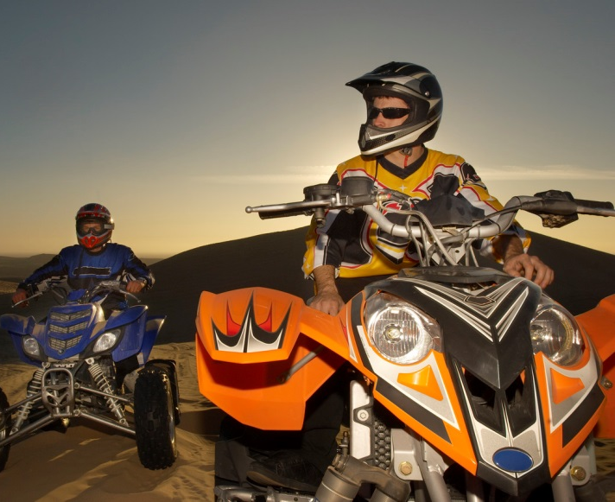
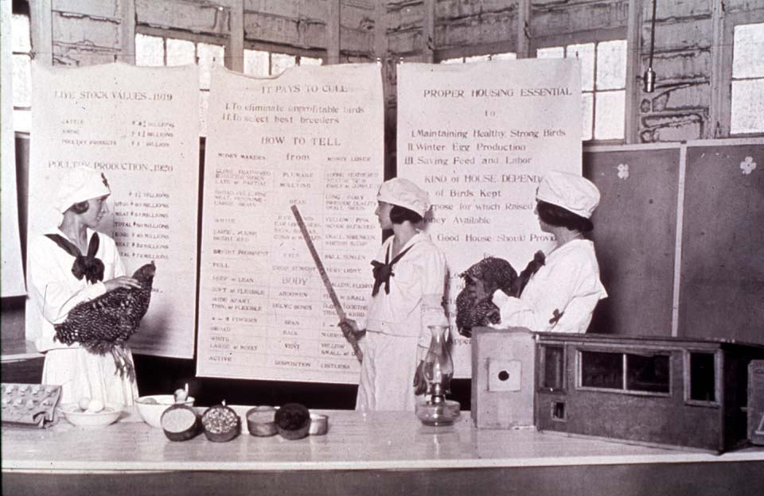
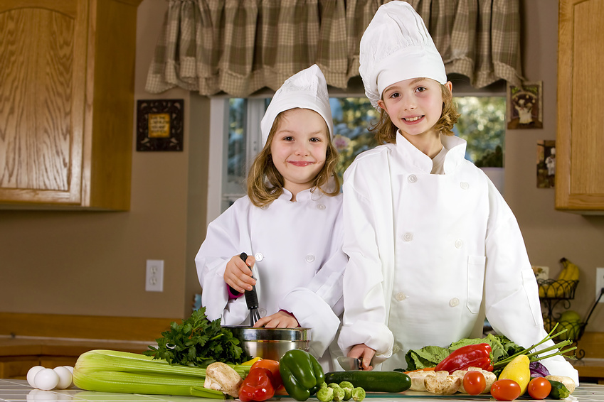
Ready, Set…Volunteer
Celebrating Diversity
oklahoma 4-h volunteer development
Notes:
Instructor Preparation – Allow 6-8 hours of preparation for 1 hour of instruction.
Review all materials thoroughly. Do any additional research or preparation to make yourself comfortable with the materials or to give it a personal touch.
Determine what other topic/subject matter will be presented with this “core” subject matter. For instance, how can 4-H encourage, embrace and teach history through special event/activity: “Famous People” category at your communication event, introducing the OK Hobbies and Collectibles project, National 4-H History Preservation Program, explore cultural awareness – through food, clothing or art, or how to develop the heritage portion of the Civic Engagement project area. Programming could even introduce the new (2018) term of Civic Engagement and the three areas it encompasses. https://4-h.org/parents/civic-engagement/ (2019)
Prepare handouts that complement the subject matter.
Continued on next slide

Slide 2

Celebrating Diversity
Oklahoma 4-H Youth Development
Parent-Volunteer Education
Teaching Outline notes continued…
Notes:
Handouts that complement this session:
Resource Material
PennState Extension https://extension.psu.edu/catalogsearch/result/?q=diversity (2/2019)
University of South California – Diversity Toolkit: A guide to Discussion Identity, Power and Privilege https://msw.usc.edu/mswusc-blog/diversity-workshop-guide-to-discussing-identity-power-and-privilege/ (2/2019)
Journal of Youth Development V7,#4, Winter 2012/Article 120704PA003 Explore the World with a Global Education Curriculum
Journal of Extension V51 Article 4FEA1 Diversity Inclusion in 4-H Youth Programs: Examining the Perceptions Among West Virginia 4-H Youth Professionals
***Photo’s and clipart downloaded from Google Images 2/2019.
Teaching Outline and Activity
Unit 3.2 Celebrating Diversity
PennState Extension – Activities (2/2019)
University of Houston – Diversity Activities (2/2019)
workSMART http://blog.trainerswarehouse.com/diversity-training-games-and-exercises/
PowerPoint Presentations
Unit 3.2 Celebrating Diversity
VRKC Positive Youth Development Skills: Appreciating Diversity
Self Study Series- for volunteers who can not attend this training in person.
4-H Newsletter Support Material
Helping Youth Understand Diversity

Slide 3
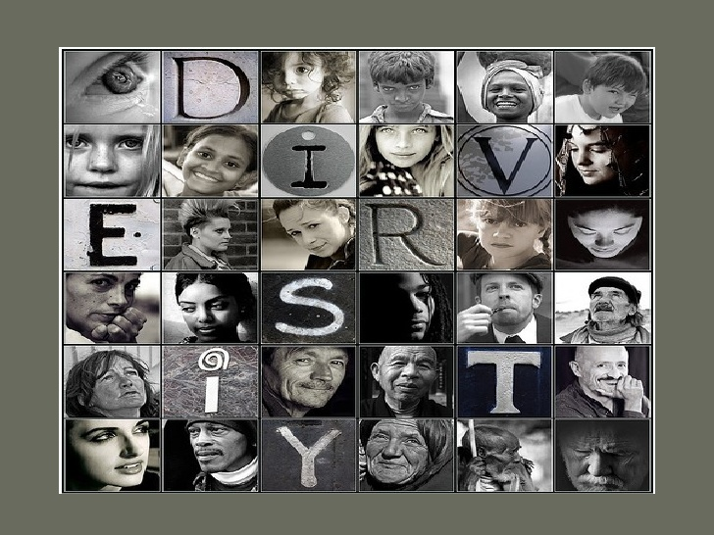
Activity
Notes:
Review the entire lesson and then look at supporting resources and activities.
Look for activities which can be used to teach or reinforce concepts.
Unit 3.2 content might be done over a period of time with discussion on pieces and part followed by a lesson that can be used in the club setting.
PennState Extenson – Diversity resources and activities for Youth and Adults
https://extension.psu.edu/catalogsearch/result/?q=diversity (2/2019)
Diversity Discussion Starters
An Overview of Diversity Awareness
Diversity Activities for Youth and Adults
Learning Today, Leading Tomorrow: Interpersonal Leadership Skills, Valuing Diversity
More Diversity Activities for Youth and Adults
Houston University https://www.uh.edu/cdi/diversity_education/resources/activities/pdf/diversity%20activities-resource-guide.pdf 2/2019
Ice Breakers
Self Awareness Activities
Stereotyping & Unpacking the isms Activities
Community Implementation Activities

Slide 4
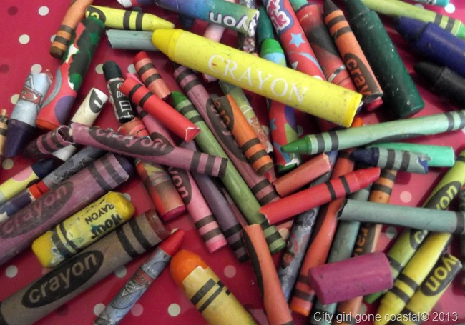
How do we benefit through inclusion?
Sensitivity - care
Cooperation
Communication
Respect
Positive influence
Connection - sharing “my” story
Trust
Sense of Fairness
We could learn a lot from crayons: some are sharp, some are pretty, some are dull, some have weird names, and all are different colors…but, they all exist very nicely in the same box.
Notes:
Review PennState Extension – Diversity Discussion Starters 4 (Crayons) and 5 (The Crayon Box that Talked) https://extension.psu.edu/diversity-discussion-starters
Have the group answer the question and then compare to the thoughts below. The bullets in the slide are not all inclusive, just a starting point.
Youth develop positive skills for being a capable and confident influence with their peers and in their communities, they learn to respect individuality and the contributions of various groups, they learn the importance of sharing their experiences which affirms their identity with regard to their own diversity, they build positive self-esteems, they learn to value just and fair treatment for all and they are better prepared for citizenship.

Slide 5
Activity
Metaphors: Healthy or unhealthy to describe diversity?
Notes:
Henze, R.C. Metaphors of Diversity, Intergroup Relations , and Equity in the Discourse of Education Leaders. JOURNAL OF LANGUAGE, IDENTITY, AND EDUCATION, 4(4), 243–267 Copyright © 2005, Lawrence Erlbaum Associates, Inc.
“The use of metaphors “implies a way of thinking and a way of seeing that pervade how we understand our world generally” (Morgan, 1986, p. 12). Not only does metaphor reveal how we understand our world, it reveals how we conceptualize social relations within that world. As Santa Ana argues, “Even though many scholars continue to assume that such metaphoric expressions are only rhetorical frills, cognitive theorists now argue vigorously for metaphor’s central role in the construction of the social order” (p. 21).”
“To promote equity as an educational leader involves, most of all, recognizing, challenging, and changing traditional power relations. Many of the metaphors that arrange space vertically allude to this need to study power relations and to make them central in one’s efforts as a leader who seeks equity. Equity involves working closely with people who are in subordinated positions vis-à-vis the traditional power structures of education, and to work closely with them, leaders must create “spaces” and opportunities where their “voices” can be heard and not squelched. Along with an explicit recognition of power relations, then, equity is concerned with representation.”
The metaphors that evoke surface and depth suggest that leaders who seek equity cannot be satisfied with “surfacy” efforts. Instead, they have to try to develop an approach that “goes deeper.” Going deeper means, among other things, recognizing the implicit, the heretofore unspoken or unacknowledged things that take place in schools. It also means that leaders have to be willing to have and facilitate “conversations” in which people talk explicitly about dangerous topics like racial, ethnic, and other tensions—conversations which could lead to overt conflicts and therefore require great understanding and skill to ensure that they are the “right conversations.”
“…. It is noteworthy that leaders used containment metaphors such as doors, gateways, and boundaries in ways that show tension between controlling (keeping bad things out) and allowing (others to come in to a space that is framed as desirable). Usually, it is the school-related spaces that are framed as desirable. Only in one case was the power dynamic shifted such that a school leader wanted access to the community.”
http://education.utsa.edu/images/uploads/Briscoe%208-31-10.pdf (2/2029)

Slide 6
Melting Pot Metaphor…
Emerged from the idea that customs and traditions of people of different races and ethnicities would blend and lose their one distinctions after close contact over time, just like ingredients mixed in a pot.
Notes:
PennState Extension: An Overview of Diversity Awareness, Tend 3
Activity - Metaphors have been used to describe diversity. Use these metaphors to facilitate discussion with the group as to why the metaphor could be perceived as healthy/unhealthy.

Slide 7
Salad Metaphor…
Used to describe a blending of ethnic characteristics much like salad ingredients tossed in a bowl. Salad ingredients do not change even when they are mixed together.

Slide 8
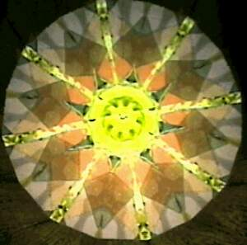
Kaleidoscope Metaphor…
When a kaleidoscope is in motions, new possibilities emerge at every turn, just like the interaction between cultural groups. This metaphor acknowledges that cultures keep changing through their interaction and yet maintain basic characteristics.
Notes:
An increased understanding of cultural similarities and differences increases Sensitivity, Communication and Cooperation in our work with children.
Why is discussion on “metaphors” key to our youth development efforts? How can we apply this discussion to growing the diversity in our clubs/SPIN groups?

Slide 9
How do we tend to define differences?
Gender
Age
Race or Ethnicity
Religion/Faith/Spirituality
Physical/mental limitation
Sexual orientation
Membership in Organizations
Notes:
Review PennState Extension – An Overview of Diversity Awareness Starters https://extension.psu.edu/catalogsearch/result/?q=diversity

Slide 10
Additional ways…
Education
Job/profession
Income/financial status
Hobby
Geographic
Marital/family status
Etc.

Slide 11
Oklahoma State University
Affirmative Action Statement
Oklahoma State University, as an equal opportunity employer, complies with all applicable federal and state laws regarding non-discrimination and affirmative action. Oklahoma State University is committed to a policy of equal opportunity for all individuals and does not discriminate based on race, religion, age, sex, color, national origin, marital status, sexual orientation, gender identity/expression, disability, or veteran status with regard to employment, educational programs and activities, and/or admissions.
Notes:
This statement will be found on publications, enrollment, charter clubs/SPIN groups, club management and program marketing. Club leaders sign a “civil rights” card as part of their club management best practices.
4-H is committed to this affirmative action statement.
Updated EEO Statement – Nov 26, 2018
http://acs.okstate.edu/toolbox/marketing/disclaimers
Oklahoma State University, as an equal opportunity employer, complies with all applicable federal and state laws regarding non-discrimination and affirmative action. Oklahoma State University is committed to a policy of equal opportunity for all individuals and does not discriminate based on race, religion, age, sex, color, national origin, marital status, sexual orientation, gender identity/expression, disability, or veteran status with regard to employment, educational programs and activities, and/or admissions. For more information, visit https:///eeo.okstate.edu
Issued in furtherance of Cooperative Extension work, acts of May 8 and June 30, 1914, in cooperation with the U.S. Department of Agriculture, Director of Oklahoma Cooperative Extension Service, Oklahoma State University, Stillwater, Oklahoma. This publication is issued by Oklahoma State University as authorized by the Vice President for Agricultural Programs.

Slide 12

Understanding Definitions
Culture: beliefs, social forms, material traits of a racial, religious, or social group; characteristic features of everyday existence shared by people in a place or time.
Ethnicity: of or relating to large groups of people classed according to common racial, national, tribal, religious, linguistic, or cultural origin or background
Race: a category of humankind that shares certain distinctive physical traits
Source: Merriam-Webster Dictionary
Notes:
Teaching and encouraging cultural awareness through 4-H programs, activities and project work increases ones understanding of cultural differences but more importantly the similarities.

Slide 13
Understanding continued…
Generalization: an oversimplification, conclusion or observation based on limited experience.
Stereotype: a standardized mental picture that is held in common by members of a group and that represents an oversimplified opinion, prejudiced attitude, or uncritical judgment (merriam-webster dictionary)
Bias: failure to be objective and impartial about people or an issue.
Prejudice: injury or damage resulting from some judgment or action of another in disregard of one's rights (merriam-webster dictionary)
Discrimination: unequal/ unfair treatment because of race, religion, age, physical ability, gender, project areas, etc.

Slide 14
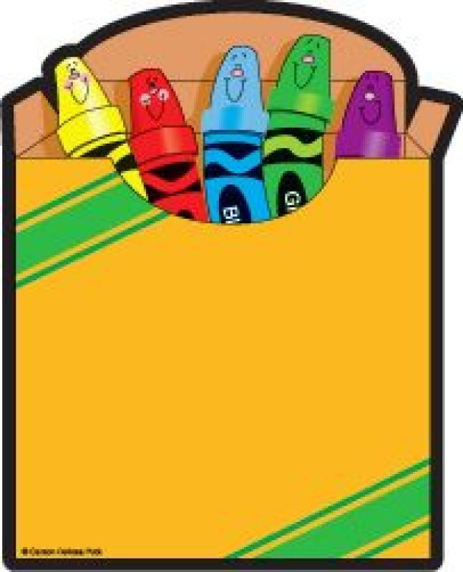
Celebrating Our Diversity
We could learn a lot from crayons: some are sharp, some are pretty, some are dull, some have weird names, and all are different colors…but, they all exist very nicely in the same box.

