Slide 1
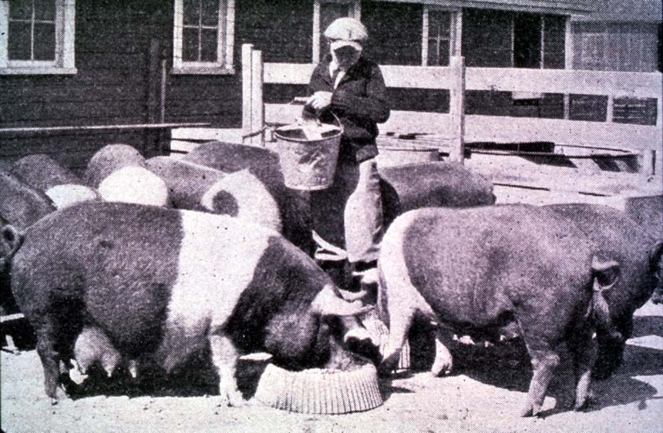
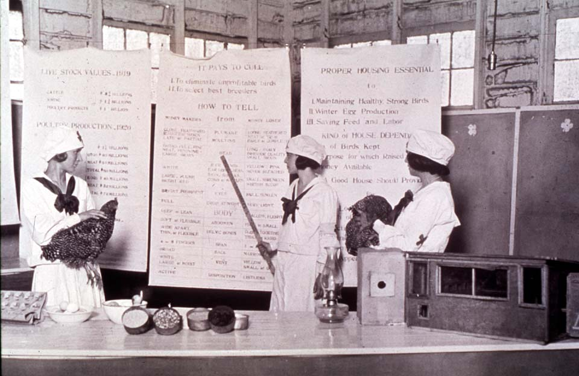
Getting the Most Out of the 4-H Experience
Life Skills Development through Project Work
Oklahoma 4-H Volunteer Development
Notes:
Instructor Preparation – Allow 6-8 hours of preparation for 1 hour of instruction.
Review all materials thoroughly. Do any additional research or preparation to make yourself comfortable with the materials or to give it your personal touch.
Determine what other topic/subject matter will be presented with this “core” subject matter. It could be a special event/activity that will focus on the CES 2014 Centennial Celebration, an educational piece on how youth should prepare for the “Famous People” category at your communication event, introducing the OK Hobbies and Collectibles project, National 4-H History Preservation Program, the heritage portion of the Citizenship project area, etc. This is a good topic to encourage, embracing and learning about History through 4-H programming.
Prepare handouts that complement the subject matter.
Down load the OCES Centennial PSA 100 Years of Oklahoma Extension (video 3:35 minutes) http://toolbox.okstate.edu/100-years to play with slide
Teaching Outline and Activity
4H101 – Lesson 6: Targeting Life Skills
Handouts that complement the session:
4H.VOL.135 Life Skills Definitions
Targeting Life Skills Model
Resource Materials
Targeting Life Skills Model
Life Skills – Definitions of skills
Targeting Life Skills Model – animated slide (2008)
PowerPoint Presentations
Unit 2 – Getting the Most Out of the 4-H Experience
This is Jeopardy
Self Study Series – for volunteers who can not attend this training in person.
4H.VOL.202A – Developing Youth through the 4-H Experience
4-H Newsletter Support Material
Life Skills Development

Slide 2
Skills vs. Life Skills
A skill is a learned ability to do something well.
Life Skills are the way one applies learned skills to real life situations.

Slide 3
Life Skills include…
Decision Making
Goal Setting
Planning, Implementing and Evaluating
Accepting Responsibility
Communication
Teamwork and Cooperation
Record Keeping
“Create a blue ribbon child
not a blue ribbon project.”

Slide 4
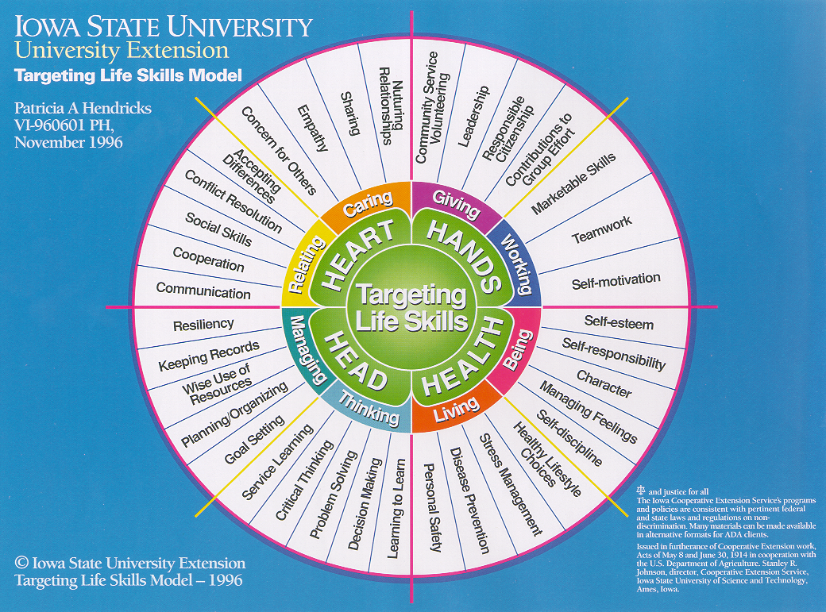
Notes:
Categories of life skills are identified and divided on the basis of the familiar four H’s from the 4-H Clover: Head, Heart, Hands and Health. There are two general categories of skill under each of the four headings.
Heart
Relating and Caring
Hands
Giving and Working
Health
Living and Being
Head
Thinking and Managing

Slide 5
Effective use of Life Skills
Life skills are to be integrated into subject matter content; not “added-on”.
Life skills are best learned when practiced at the developmental level of the learner.
One or more skills should be included in any one educational experience.
“Aim youth toward life skills development using the four H’s on the Target Model.”

