Slide 1
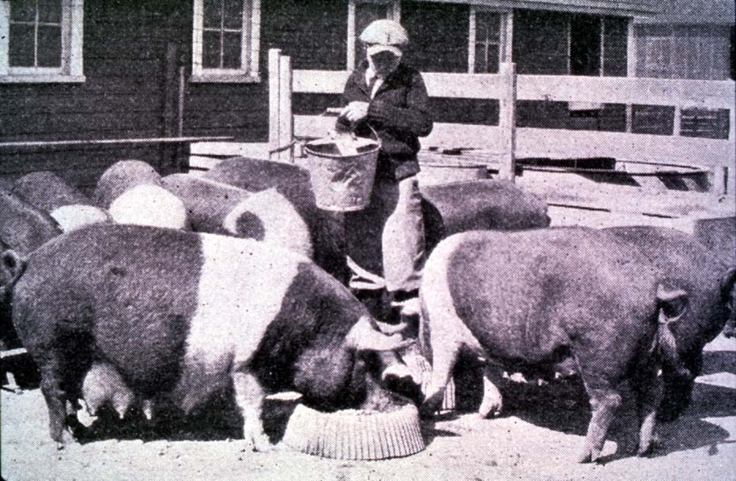
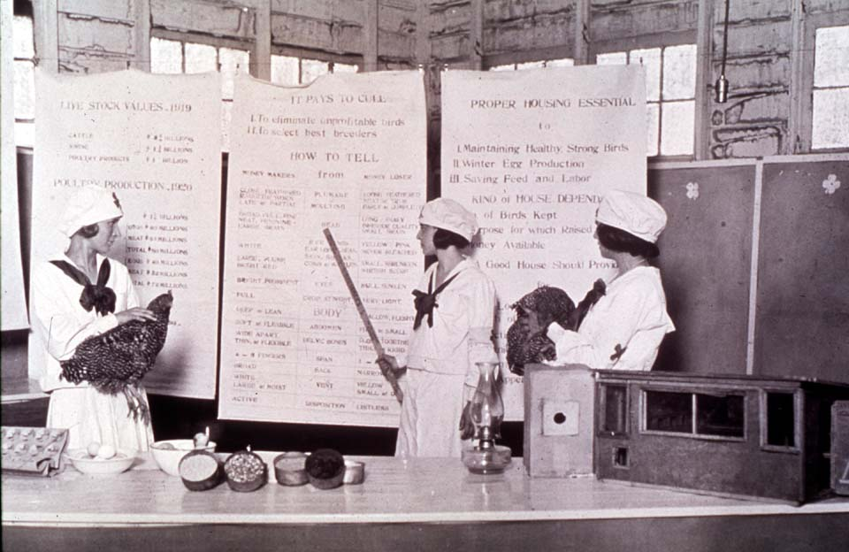
This is 4-H
Roles in 4-H
oklahoma 4-h volunteer development
Notes:
Instructor Preparation – Allow 6-8 hours of preparation for 1 hour of instruction.
Review all materials thoroughly. Do any additional research or preparation to make yourself comfortable with the materials or to give it your personal touch.
Determine what new project/subject/topic will be introduced or reviewed in conjunction with this “core” subject matter.
Provide sample curriculum or links for resources.
In preparation for teaching this section refer to Volunteer Management and Club Management Manuals for additional information on position descriptions and roles.
Teaching Outline
Unit 1: Roles in 4-H
PowerPoint Presentations
Unit 1: Roles in 4-H
This is 4-H Jeopardy
This is 4-H Jeopardy - Questions and Answers
Activities
4-H Roles and Responsibilities_Activity Sheet
4-H Roles and Responsibilities - Answers
4-H 101 Lessons
Lesson 13B_Roles and Responsibilities
Activity 13B_Roles and Responsibilities
Handouts
Being a 4-H Parent
Newsletter Support Materials
4-H Creed for Members
4-H Creed for Volunteers
4-H Parents Pledge
Ad for Volunteers
Blue Ribbon Kid: Moral to the Story
Families Role in 4-H
My Role as a Parent or Guardian
Role of the Extension Educator
So You're a 4-H Parent_Guardian
Stay Informed
This I Believe
What's in a Name?
Self Study Series
4HVOL201F_4-H Roles and Responsibilities
Answers_Unit 1 4H.VOL.201F

Slide 2
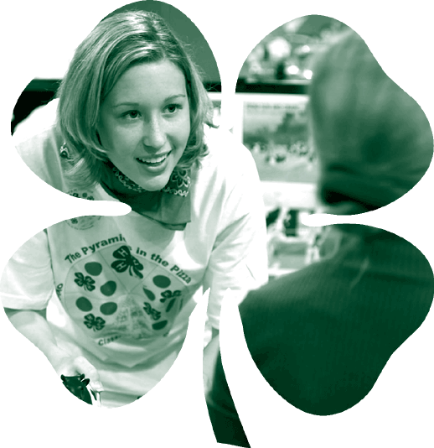
4-H Roles
4-H Member
Family
Certified Volunteer
Volunteer
Extension Educator
Notes:
Everyone involved with the 4-H program has a role and responsibilities. The program is a very large extended family that requires everyone's time, talents and resources to meet the needs of the youth enrolled in the program.

Slide 3
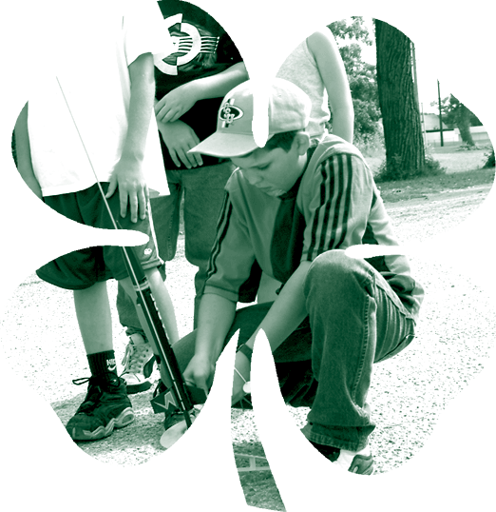
4-H Member
Take responsibility for setting goals, working toward the goals, keeping records and being a role model in deeds and actions.
4-H Roles
Notes:
·4-H members are responsible for systematically masters knowledge and skills in one or more 4-H Project areas.
The boy or girl takes responsibility setting goals - learning to plan the work.
The member is responsible for working toward the goals - Work the Plan.
Through project work 4-H member are learning to learn - acquiring, evaluating and using information, as well as understanding the methods and skills for learning.
In an effort to record what they are learning the child is encouraged to keep records. Recording selected useful information.
As a result of accepting responsibility and participating in 4-H programming the young person is developing moral strength and character, integrity and fortitude.

Slide 4
Family
Encourage participation in 4-H programs at the local and county level and to assist in the development of the 4-H member.
Support local and county 4-H program through time, talent and financial support.
Work cooperatively with other families and 4-H volunteers.
Participate in Parent-Volunteer Training to enhance personal knowledge of 4-H, as well as, to assist and guide your child.
4-H Roles
Notes:
Family is essential to the success of the member. They require a support system that encourage participation in a variety of 4-H programs at the local and county level . Participation assist in the total development of the child.
Parents must support local and county 4-H program through time, talent, skills and financial support. A 4-H program requires many adults in a variety of leadership roles to provide quality programming.
Each family comes to the 4-H family with unique talents and character. Through programming we all learn to work cooperatively with other families and 4-H volunteers. for the well being of the youth and program.
Families need to participate in Parent-Volunteer Training to enhance personal knowledge of 4-H, as well as, to assist and guide the child.
Parents should also be involved with the Parent-Volunteer Association or Leaders Council.

Slide 5
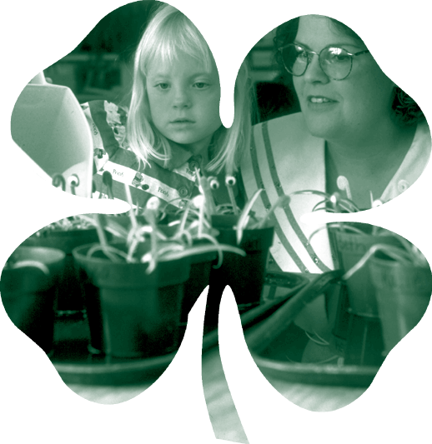
Certified Volunteer
Have participated in a selection process and orientation session.
Annually participate in Parent-Volunteer training, enroll and agree to accept and follow the Oklahoma 4-H Behavioral Guidelines.
4-H Roles
Notes:
Oklahoma 4-H is dedicated to providing our members with a safe environment to learn and caring adults providing positive youth development programming.
For the protection of our members and the volunteers we have a volunteer certification process in place for recruiting, selecting and training volunteers who work directly with 4-H members.
To maintain certification volunteers must annually participate in Parent-Volunteer Training opportunities, re-enroll and review and agree to abide by the Oklahoma 4-H Behavioral Guidelines.

Slide 6
Volunteer
Provide leadership to the local and county 4-H program. Leadership will include planning, developing, implementing and evaluating programs and activities.
Work cooperatively with 4-H families, volunteers and Extension Educators.
Participate in Parent-Volunteer Training to enhance personal knowledge of 4-H and to assist in the development of 4-H members.
4-H Roles
Notes:
4-H volunteers are vital to a success 4-H program. Volunteers wearing lots of different hats and providing their time, talents and resources at the club and county level.
Leadership will include planning, developing, implementing and evaluating educational programs and activities.
Being a positive role model and working cooperatively with 4-H families, volunteers and Extension Educators.
Each volunteer is dedicated to enhancing their personal knowledge of 4-H and acquiring project knowledge by participating in continuing education offered at the county, district and state levels.

Slide 7
Extension Educator
Provide leadership and direction to local and county 4-H program.
Para-professionals provide support to the Extension Educator.
Provide Parent-Volunteer Training at the county, district and state levels. Training shall provide the tools and knowledge that parents and volunteers need to successfully implement, maintain and develop 4-H clubs and members.
Provide the support and training for the implementation of a volunteer led program at the local and county level.
Work cooperatively with volunteers, families and 4-H members.
4-H Roles
Notes:
Extension educators and Para-professionals are responsible for the management, leadership and direction of the total 4-H Youth Development program in the county. To accomplish the task they surround themselves with trained volunteers dedicated to the 4-H youth development principles.
County educators provide Parent-Volunteer Training at the county, district and state levels. Training provides the tools and knowledge that parents and volunteers need to successfully implement, maintain and develop 4-H clubs and members.
Their goal is to provide the support and training for the implementation of a volunteer led program at the local and county level.
The county educator will be the catalyst to keep everyone focused on working cooperatively. Making decisions which provide a fun, educational and quality experience for the 4-H member.

Slide 8
Activity
4-H 101 – Roles and Responsibilities
Notes:
4-H 101 Activity 13 B provides a excellent example of how the work load needs to be shared by everyone.

